Slide 1
E.a.p. – a new model
(equine assisted psychotherapy)
Learning to model a new spiritual and emotional language

Slide 2
Traditional & current western cultural norms:
Exploitation, Division, Racism
Authoritarianism, Top-Down Hierarchies
Abuse, Neglect, Indifference
Violence or the Threat of Violence…Control
Narcism; "The emphasis on individualistic society provides an underpinning for cultural values that permeate Western society and influence every aspect of life, including mental health and psychological well-being." (Bemak & Chung, 2012, pp. 56-57)

Slide 3
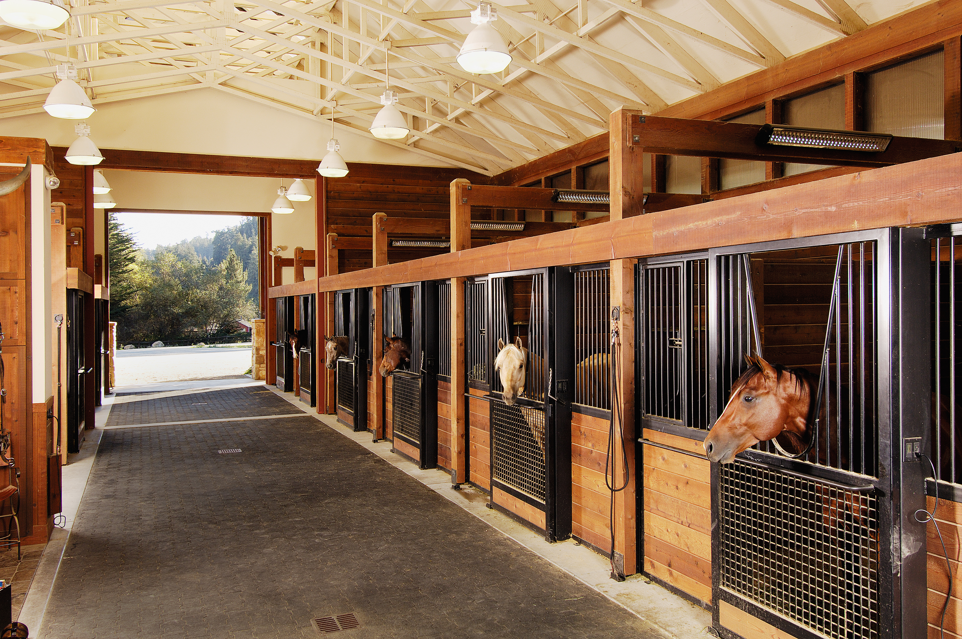
What does this resemble? (other than a horse stable)

Slide 4
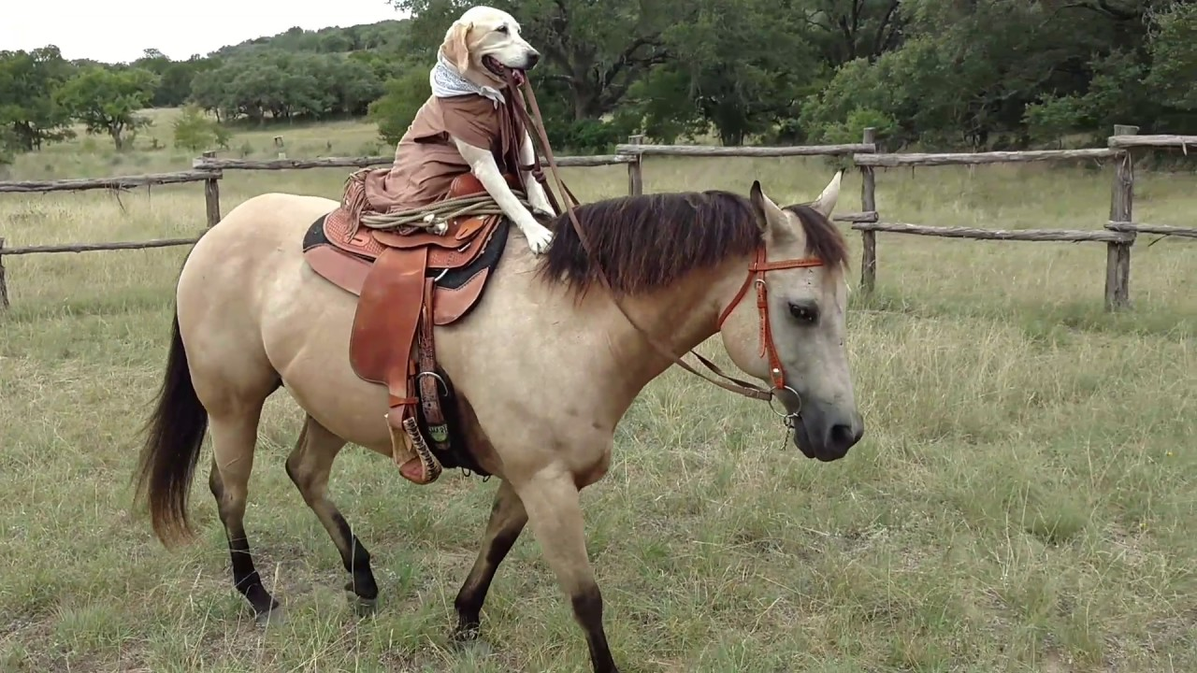
What does this resemble? (other than a dog riding a horse)

Slide 5

Identity:

Slide 6
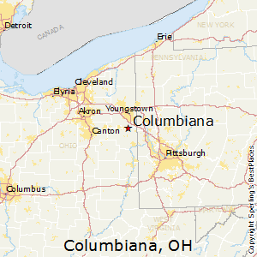
New Way Farm, LLC (Nieuwe Manier Farm)
Columbiana, ohio

Slide 7
part I: Theoretical and historical frame what are the scholarly perspectives on the causes, consequences, and possible solutions to the social justice challenge you’re addressing?
a) How am I defining the challenge?
b) What about its causes, consequences, and potential solutions do the scholars agree upon?
c) What do they disagree about?
d) Where do I stand in this debate, and why?

Slide 8
a) How am I defining the challenge?
Traumatization and PTSD symptoms lead to great suffering, the Midwest has been hit relatively very hard (unemployment/SUDs)
"The situation in this Ohio/Pennsylvania MSA is not atypical: roughly 25% of all MSAs have lost manufacturing jobs since 2010. Clearly individuals are either stuck with lower paying jobs or are trying to train themselves to work in industries that require higher skill levels." (Gallagher, 2019, p. 9)
"Ohio ranks second among states in drug overdose deaths, with more than 39 deaths for every 100,000 people." (Russell, Spence, & Thames, 2018, p. 702).

Slide 9
a) How am I defining the challenge? (cont.) - Comorbidity
"In the cohort of the Operation Iraqi Freedom/Operation Enduring Freedom, 18 to 20% of veterans met criteria for PTSD, and of those, about 20 to 30% reported increased drinking immediately after returning from Iraq...with rates of alcohol consumption increasing with the level of combat exposure…"; over time or the sheer inescapability from them leads many sufferers to eventually self-medicate: "The prevalence rates generally tend to increase over time with rates ranging from 37 to 39.1% for PTSD and 23.4 to 26.5% for hazardous drinking"; (Jackson et al., 2016, p. 1).
"...higher levels of stress-induced anxiety, predict shorter time to relapse..."; "...laboratory studies in individuals with AD, which use scripts of personally experienced stressful or alcohol-related events, have shown that (i) stress reliably elicits craving..."; (Jackson et al., 2016, p.2).

Slide 10
a) How am I defining the challenge? (cont.) - Comorbidity
"PTSD symptom severity was a strong predictor of craving elicited by trauma cues..." (Jackson et al., 2016, p.1); "When both disorders occur together, this comorbidity is associated with more severe impairment, poorer treatment prognosis, more severe symptoms of PTSD, higher relapse rates, higher reports of family problems, and heavier drinking when compared to individuals with either AD or PTSD alone..." (Jackson et al., 2016, p. 1).

Slide 11
a) How am I defining the challenge? (cont.) – Effects of violence
"A variety of investigators has demonstrated that youths’ experiences as witnesses and/or victims of violence are associated with elevated levels of anxiety, depression, and similar syndromes, including posttraumatic stress disorder...violent and non-violent antisocial behavior...substance use and abuse...academic performance...antisocial belief systems...and emotional dysregulation" (Boxer, Middlemass, & Delorenzo, 2009, p. 794).
“…research has shown that individuals reporting high levels of witnessing, as well as victimization by, violence also report higher levels of depression, aggression, posttraumatic stress, and interpersonal problems in comparison with individuals reporting low levels of violence exposure.” (Boxer, Middlemass, & Delorenzo, 2009, p. 795)

Slide 12
a) How am I defining the challenge? (cont.) – Prison - victim blaming worsening symptoms
"Lifetime violence experienced by incarcerated women has been characterized as severe, far exceeding experiences of women in the general population..." (Andrea, Cimino, Kunz, Mendoza, Shively, & Thieleman, 2015, p. 2)
"Possible PTSD was one of the most prevalent mental health conditions, with 48.1% of male inmates and 57.8% of female inmates having indications of a possible diagnosis. Other prevalent conditions included inmates with at least one substance use disorder (85.5%), at least one severe substance use disorder (67.5%)" (Combs et al., 2019, p. 10)

Slide 13
a) How am I defining the challenge? (cont.) –
Prison - victim blaming worsening symptoms
"While the United States has only 5 percent of the world's population, it has nearly 25 percent of its prisoners - about 2.2 million people...One out of every 100 American adults is incarcerated, a per capita rate five to 10 times higher than that in Western Europe or other democracies..." (Collier, 2014)
"While the United States has 707 incarcerated people per 100,000 citizens, for example, China has 124 to 172 per 100,000 people and Iran 284 per 100,000. North Korea is perhaps the closest, but reliable numbers are hard to find; some estimates suggest 600 to 800 per 100,000." (Collier, 2014)

Slide 14
a) How am I defining the challenge? (cont.) –
Prison - victim blaming worsening symptoms
"This growth is "historically unprecedented" in the United States and "internationally unique..." (Collier, 2014)
“Even states like New Hampshire, with incarceration rates below the national average, continue to lock people up at more than double the rates of our closest international allies” (Wagner & Sawyer, 2018)

Slide 15
a) How am I defining the challenge? (cont.) - Prison - victim blaming worsening symptoms
“…incarcerated women demonstrate significantly higher rates of posttraumatic stress disorder (PTSD)...with up to 81% of incarcerated women having experienced five or more traumatic events in their lifetime...Among incarcerated women, incidences of co-occurring SUD and PTSD are substantial..." (Cimino, Kunz, Mendoza, Shively, & Thieleman, 2015, p. 2).
"From a person-in-environment perspective, addressing risk factors in the community is critical because alcohol and drug use is predictive of recidivism for both men and women..."; (Cimino, Kunz, Mendoza, Shively, & Thieleman, 2015, p. 2)

Slide 16
a) How am I defining the challenge? (cont.) – America…and “the world”
America: “An estimated 19.1% of U.S. adults had any anxiety disorder in the past year.” (National Institute of Mental Health, 2017)
America: “An estimated 31.9% of adolescents had any anxiety disorder; The prevalence of major depressive episode was highest among adults reporting two or more races (11.3%).” (National Institute of Mental Health, 2017)
World Wide: “More than 300 million people are now living with depression, an increase of more than 18% between 2005 and 2015. (World Health Organization, 2017)

Slide 17

a) How am I defining the challenge? (cont.)
I want to takes clients from this road….

Slide 18
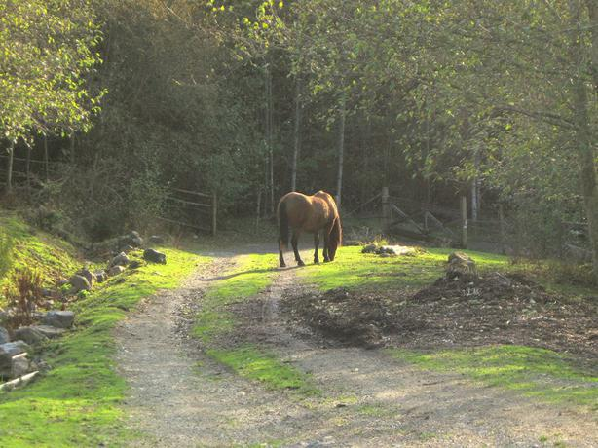
a) How am I defining the challenge? (cont.) to this one….

Slide 19
b) What about its causes, consequences, and potential solutions do the scholars agree upon?
"...horses may model a present focus as imposing animals may encourage attention....are highly responsive to humans...horses respond to human gestures. Horse responses may provide immediate feedback about a person’s nonverbal behavior (e.g., horses may crowd a person who is hunched and avoiding eye contact or back away from a person who is approaching quickly with prolonged eye contact), helping increase awareness of one’s behaviors and emotions....“ (Earles, Vernon, Yetz, 2015, p. 150)
"Participants engaged in tasks with horses for 6 weekly 2-hour sessions. Immediately following the final session, participants reported significantly reduced posttraumatic stress symptoms, d=1.21, less severe emotional responses to trauma, d=0.60, less generalized anxiety, d=1.01, and fewer symptoms of depression, d=0.54. As well, participants significantly increased mindfulness strategies, d=1.28, and decreased alcohol use..." (Earles, Vernon, Yetz, 2015, p. 149).

Slide 20
b) What about its causes, consequences, and potential solutions do the scholars agree upon? (cont.)
"Prison-based animal programs have shown promise when it comes to increased sociability, responsibility, and levels of patience for inmates who participate in these programs.“ (Allison & Ramaswamy, 2016, p. 472)

Slide 21
c) What do scholars disagree about?
“…there is a lack of empirically supported research on active treatment components in EAMH...and even less research on how group dynamics and developmental processes differ when horses are present.” (Schroeder, Stroud, Sherwood, & Udell, 2018)
“…in order for group therapeutic factors to be activated in animal-assisted groups, group leaders need to be intentional about how they integrate animals into the group experience.” (Schroeder, Stroud, Sherwood, & Udell, 2018)
“…horses did not have to be involved in a session for group members to build interpersonal bonds amongst each other.” (Schroeder, Stroud, Sherwood, & Udell, 2018)

Slide 22
c) What do scholars disagree about? (cont.)
“...findings from studies on ERT provide inconsistent and less than compelling support for its efficacy in the treatment of any mental disorder...several studies with control groups were unable to demonstrate favorable results for ERT. Given the lack of consistent follow-up data, the absence of treatment manualization or integrity checks, and several consistent threats to validity...the results fall well short of the standards set forth for establishing empirical support for treatments...” (Anestis, Anestis, Zawilinski, & Hopkins, 2014)

Slide 23
c) What do scholars disagree about? (cont.)
“…the treatment group did not decrease significantly more than the control group. These findings suggest that EFP may be an effective additional treatment modality for post-traumatic stress symptoms, but there was no evidence from this initial study that EFP was significantly more effective than traditional office-based therapy.” (Mueller, McCullough, 2017)

Slide 24

d) Where do i stand in this debate, and why?

Slide 25
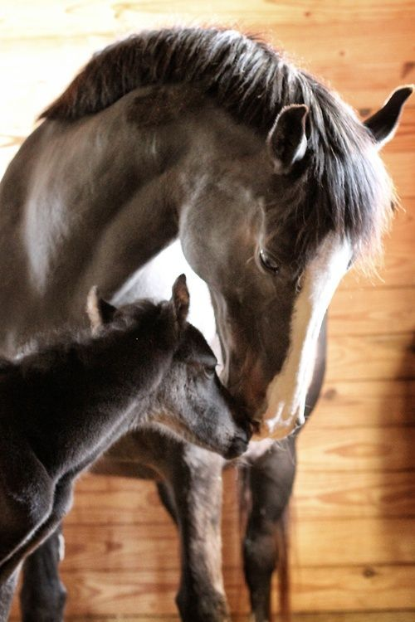
d) WHERE DO YOU STAND IN THIS DEBATE, AND WHY?
PERSONAL EXPERIENCE 2018; CANFIELD (OHIO) FAIR

Slide 26
d) WHERE DO YOU STAND IN THIS DEBATE, AND WHY? (cont.) – reprograming the soul…
“Unlike other memories, memories of traumatic events may seem to have vague cognitive content. Rather, they often are sensory fragments such as sights, sounds, smells, or kinesthetic sensations and emotional states...." (Substance Abuse and Mental Health Services Administration, 2009, pp. 182-183) [kinesthetic = physical sensory]
“…we must be able to combine our clinical role with psychoeducational work and interventions in larger systems that impact the client, so that we become consultants, advocates, advisors, teachers, facilitators of indigenous healing, and so on.” (Bemak & Chung, 2012, p. 16)

Slide 27
Part II: Practical frame
What are the local stakeholders’ perspectives on the causes, consequences, and possible solutions to the social justice challenge
a) What do the stakeholders agree upon?
b) What do the stakeholders disagree about?
c) How do the stakeholder’s perspectives compare/contrast with the scholars’ perspectives?
d) Where do you stand in this debate, and why?

Slide 28
a) What do the stakeholders agree upon?
“In regards to recovery from adverse experiences, people have described the horse-human bond as a partnership of nonjudgmental acceptance and nurturance, which restored their sense of identity and life purpose…” (Yorke, Adams, & Coady, 2008).
“Women have reported that therapeutic interactions with horses are emotionally grounding, instill feelings of courage and hope, and help them navigate interpersonal boundaries problems…” (Shambo, Young, & Madera, 2013)

Slide 29
a) What do the stakeholders agree upon? (con.t) – Anecdotal suds patients:
“…doing something useful”; “I feel that I do something. Something that’s important – to others, and of course, that’s a good feeling” (Kern-Godal, Halvorsen Brenna, Ajo Arnevik, Ravndal, 2016, p. 4)
“Mostly, it has to do with the responsibility. To have someone that is dependent on you, because it becomes a commitment. That’s not something I’ve been that good at earlier. So I have absolutely found something in the horse therapy…" (Kern-Godal, Halvorsen Brenna, Ajo Arnevik, Ravndal, 2016, p. 5)
“There’s no talk of drugs, or thoughts about drugs at all, it’s just to focus on the horses and how the day in there will be, in the stable. It’s very good motivation to think ahead in my life…” (without drugs)” (Kern-Godal, Halvorsen Brenna, Ajo Arnevik, Ravndal, 2016, p. 5)

Slide 30
a) What do the stakeholders agree upon? (con.t) – Anecdotal general patients:
“…body awareness: "I noticed that she is irritated because I’m stressed out, because there and then, I suddenly realised that I was stressed out. I remember only my breathing: I had a hectic way of breathing, from the top of my chest…" (Johansen, Arfwedson Wang, Binder, 2016, p. 6)
“…(...) the reason is that I have been acting stressful, like really. Guaranteed it’s had an influence on her and when I managed to breathe calmly and calm myself down, it calmed the horse down right away too. Getting that message made me realise things.(..) The moment you rush, the horse does the same." (Johansen, Arfwedson Wang, Binder, 2016, p. 6)

Slide 31
a) What do the stakeholders agree upon? (con.t) – Anecdotal veteran w/ptsd patients:
“It will make me view my difficulties with PTSD in a completely new positive light.”; “…trust…was strengthened by my experience here,” and that it “can be transferred to everyday life.” (Ferruolo, 2016, p. 5)
“…working “with the horses was...probably the most spiritual experience I had in a long time.”; “…my biggest takeaway...was the beauty, power, serenity, and majesty of God’s creation, the horse,”; “…what I take away from this program is peace, pride, and joy.” (Ferruolo, 2016, p. 5)

Slide 32
a) What do the stakeholders agree upon? (con.t) – Anecdotal veteran w/ptsd patients:
”It taught me a lot about how I carry myself and interact with people…Working as a team is far more effective than working by myself.”; “Learning about how I act with the animals relates to how I can act with humans in a better way.”; “…the interaction will help me respect people and their different personalities.” (Ferruolo, 2016, p. 5)

Slide 33
b) What do the stakeholders disagree about?
Some people are simply indifferent towards animals – does nothing for them
Potential allergies and lack of availability.
Riding – many EAP programs focus on riding.
https://www.eagala.org – this organization seems to be the most popular of the EAP organizations out there. They offer training and accreditation so EAP facilitators can align themselves with them. However, they also model what I believe to be complete exploitation of the animals.

Slide 34
c) How do the stakeholder’s perspectives compare/contrast with the scholars’ perspectives?
Stakeholders tend to be more universally pro.
Scholars are not convinced due to a lack of empirical data.
Scholars struggle with “control” in research of EAP:
“The little empirical evidence that is available about the efficacy of equine-assisted interventions on psychological outcomes tends to be mixed and is often difficult to interpret due to the lack of rigorous research designs….The little empirical evidence that is available about the efficacy of equine-assisted interventions on psychological outcomes tends to be mixed and is often difficult to interpret due to the lack of rigorous research designs….Well-designed randomised controlled trials are greatly needed in this area…” (Byrne et al., 2013)

Slide 35
d) Where do i stand in this debate, and why? again: PERSONAL EXPERIENCE 2018; CANFIELD (OHIO) FAIR

Slide 36
d) Where do you stand in this debate, and why? (cont.)
I favor non-riding (exploitative)
Natural Horsemanship – natural environment, non-stabling (walk-in barn) - autonomy for the animal
Viewing the horse as a stakeholder as well
EAP DOES work according to my personal experiences – The limited times spent on farms growing up are perhaps the most memorable and positive experiences – a lot of “take away”.

Slide 37
Part III: Proposal for action
Specifically, what do you propose that our social justice community do to address the challenge you’ve identified?
a) Begin your proposal with a succinct overview of the action, and then break it down step by step, with a timeline.
b) Discuss whose cooperation you’ll need and how you’ll win it.
c) Discuss likely sources of resistance to your action and how you’ll negotiate them. – city council, zoning board – form alliances with the local Mennonite community / business owners.

Slide 38
a) Begin your proposal with a succinct overview of the action, and then break it down step by step, with a timeline.
State-of-the-art Equine Assisted Psychotherapy (EAP) facility to address the mental health needs in the area as they relate to adult trauma survivors - develop a model to be replicated by others.
PHASE I: Land acquisition, $450,000; property w/self-sustaining hay supply with preexisting land leases - to be completed within the 1st quarter.
PHASE II: Horse barn, $140,000; walk-in horse barn containing two very “rustic” rooms for individual therapy as well as group therapy, with gas heat, electricity, pump wells, compost toilets, and washer/dryer - to be completed within the 2nd quarter.

Slide 39
a) Begin your proposal with a succinct overview of the action, and then break it down step by step, with a timeline. (cont.)
PHASE III: Operating start-up, $100,000 (in order); fencing ($20K), tractor w/implements ($45K), misc. such as feeders, water heaters, furnishings, etc. ($15,000), 8-10 horses / 3 donkeys /10 goats / 2 pigs ($20K).
TOTAL: $690,000 dispersed within 3 the quarters with allotments in succession once the preceding phase has been completed.

Slide 40
b) Discuss whose cooperation you’ll need and how you’ll win it?
Local Businesses: I will appeal to “good will” element of business within the community and stress that backer’s names will remain associated with the project. I will first seek backers then builders (contractors) prior to meeting with the local government.
City council / Zoning board: I will ingratiate the proposal promoting good will and community reputation / promotion. This community is concerned with preserving its agricultural image as well as some tourism.

Slide 41
c) Discuss likely sources of resistance to your action and how you’ll negotiate them.
City council / zoning board: I intent on seeking alliances with the local Mennonite community / business owners. The existing lessor of the fields is a Mennonite family who operates a large grain business within the community.
Ongoing support: Will be sought in parallel with seeking the initial investment; things such as feed, supplies, tax incentives, etc.
Promotion: If needed, will be done via the internet; the solicitation of local mental health clinics and mental health care providers; as well as various media outlets.

Slide 42
Part IV: Justification
Why should the community — our LLC, the campus community, and/or the wider community — join you in this action?
a) How does the action you propose address the challenge as you discussed it in Part I? That is, how does it speak to the scholars’ arguments?
b) How does it address the issues raised in Part II? That is, how does it fir with the stakeholders perspectives and meet their concerns?
c) How does it advance values that our LLC, the campus community, and/or the wider community share?

Slide 43
a) How does the action you propose address the challenge as you discussed it in Part I? That is, how does it speak to the scholars’ arguments?
Measurability: We will obtain feedback both directly and indirectly via the participant and his or her counselor, respectively.
BDI, BAI, as well as In-house Trauma-symptom Surveys: We will provide these forms periodically and ask the client to fill them out and bring them back upon his or her next visit to be added to his or her file. We will also ask the participant’s counselor to forward us any documentation as it relates to the client’s progress as it relates to our EAP treatment.

Slide 44
a) How does the action you propose address the challenge as you discussed it in Part I? That is, how does it speak to the scholars’ arguments? (cont.)
Client/patient affordability: We intend on accepting Medicaid as well as offering sponsorships. We will market these sponsorships (donations) for those who’d like to finance random client’s EAP treatment at our facility. Sponsorship money will then be used to offer treatment to those who have no insurance coverage and cannot afford treatment on their own.

Slide 45
b) How does it address the issues raised in Part II? That is, how does it fit with the stakeholder’s perspectives and meet their concerns?
Stakeholders can experience EAP without riding and see if it’s for them
They will be introduced to Natural Horsemanship and potentially learn a new language of respect, the observance and preservation of dignity and autonomy, and see it these things connect with them on a soul-level, or in a healing way.
"...we found evidence that the Equine Partnering Naturally © approach to equine-assisted therapy maybe an effective treatment for anxiety and posttraumatic stress symptoms. ....“ (Earles, Vernon, Yetz, 2015, p. 149).

Slide 46
c) How does it advance values that our LLC, the campus community, and/or the wider community share?
Humanistic: Human / animal interaction stressing respectful, symbiotic relationships with other living organisms; a reminder and even perhaps a re-education of the potential and positive possibilities of the human experience.
Organic: The experiencing of a potential deeply felt and realized ‘human connection’.
Promotion of Mastery: "...clients who are experiencing high levels of anxiety, depression, anger, frustration, or stress due to their inability to effectively understand and resolve problems and concerns in their social and community life may be far better off working on mastering their environment and developing appropriate responses..." (Bemak & Chung, 2012, p. 87).

Slide 47
c) How does it advance values that our LLC, the campus community, and/or the wider community share? (cont.)
Indigenous forms interaction: Possible healing, and spirituality of a bygone era which may indeed build upon “modern”, Western forms of psychotherapy and mental health treatment in general.
"...Western mental health has emphasized intrapsychic processes, neglecting the importance of social and cultural factors and the relevance of spiritual and supernatural forces that contribute to psychological well-being..." (Bemak & Chung, 2012, p. 89).

Slide 48
c) How does it advance values that our LLC, the campus community, and/or the wider community share? (cont.)
Replication: Potentiality for creating a new model to be replicated on a mass scale

Slide 49
References:
Allison, Molly; Ramaswamy, Megha (2016). Adapting Animal‐Assisted Therapy Trials to
Prison‐Based Animal Programs; Public Health Nursing; Vol. 33, Iss. 5, September/October
2016, pp. 472-480.
Andrea, Cimino; Kunz, Kami; Mendoza, Natasha; Shively, Randy; Thieleman, Kara; 2015.
Women Reentering the Community: Understanding Addiction and Trauma-Related
Characteristics of Recidivism. Journal of Human Behavior in the Social Environment.
Jul2015, Vol. 25 Issue 5, p468-476. 9p.

Slide 50
References:
Anestis, Michael D.; Anestis, Joye C.; Zawilinski, Laci L.; Hopkins, Tiffany A.; Lilienfeld, Scott
O.; 2014. Equine-Related Treatments For Mental Disorders Lack Empirical Support: A
Systematic Review of Empirical Investigations. Journal of Clinical Psychology Journal of
Clinical Psychology. Dec2014, Vol. 70 Issue 12, p1115-1132. 18p. 2 Charts. DOI:
10.1002/jclp.22113.
Association Logo; October 2014, Vol 45, No. 9; Available at
https://www.apa.org/monitor/2014/10/incarceration

Slide 51
References:
Boxer, Paul; Middlemass, Keesha; Delorenzo, Tahlia (2009). Exposure to Violent Crime
During Incarceration; Criminal Justice and Behavior; Vol. 36, Iss. 8, August 2009, pp. 793
-807.
Bemak, Frederic P.; Chung, Rita Chi-Ying; 2012. Social Justice Counseling: The Next Steps
Beyond Multiculturalism in Application, Theory, and Practice; SAGE Publications.

Slide 52
References:
Byrne, Jason; Downes, Kendall, Martin; Elizabeth; Lakhani, Ali; Macfarlane, Kym; Maujean,
Annick & Pepping, Christopher A.; 2013. A systematic review of the efficacy of
equine-assisted interventions on psychological outcomes; European Journal of
Psychotherapy & Counselling Volume 17, 2015 - Issue 1; Pages 57-79 | Received 15 Feb
2013, Accepted 16 Oct 2014, Published online: 12 Mar 2015.
Collier, Lorna; 2014. Incarceration nation; The United States leads the world in incarceration. A
new report explores why — and offers recommendations for fixing the system. American
Psychological.

Slide 53
References:
Combs, Elizabeth; Guston, Kaitlin; Hoffmann, Norman; Kopak, Albert; Raggio, Alyssa; 2019. A
PTSD Screen for Forensic Populations; International Journal of Offender Therapy and
Comparative Criminology; Vol. 63, Iss. 1, January 2019, p. 86.
Earles, Julie L.; Vernon, Laura L.; Yetz, Jeanne P.; 2015. Equine-Assisted Therapy for Anxiety
and Post traumatic Stress Symptoms. Journal of Traumatic Stress. Apr2015, Vol. 28 Issue
2, p149-152. 4p. 1 Chart. DOI: 10.1002/jts.21990.
Ferruolo, David M. 2016. Psychosocial Equine Program for Veterans. Social Work. Jan2016,
Vol. 61 Issue 1, p53-60. 8p.

Slide 54
References:
Gallagher, Eamon; 2019. All Recessions Are Not Equal: The Effect of Sectoral Shifts on
Unemployment Using Regional Data" (2019). CMC Senior Theses. 2261.
Jackson E; Jane JS; Petrakis, I; Ralevski E; Russo M; Southwick S; 2016. Trauma-and
Stress-Induced Response in Veterans with Alcohol Dependence and Comorbid
Post-Traumatic Stress Disorder; Alcoholism, Clinical And Experimental Research [Alcohol
Clin Exp Res], ISSN: 1530-0277, 2016 Aug; Vol. 40 (8), pp. 1752-60; Publisher:
Wiley-Blackwell; PMID: 27368085.

Slide 55
References:
Johansen, Siv G.; Arfwedson Wang, Catharina E.; Binder, Per ‐ Einar; 2016. Facilitating change
in a client's dysfunctional behavioural pattern with horse-aided psychotherapy. A case
study. Counselling & Psychotherapy Research. Sep2016, Vol. 16 Issue 3, p222-231. 10p.
DOI: 10.1002/capr.12078.
Kern-Godal, Ann; Halvorsen Brenna, Ida; Ajo Arnevik, Espe; Ravndal, Edle; 2016. More Than
Just a Break from Treatment: How Substance Use Disorder Patients Experience the Stable
Environment in Horse-Assisted Therapy. Substance Abuse: Research & Treatment. 2016,
Vol. 10, p99-108. 10p.

Slide 56
References:
Mueller, Megan; McCullough, Leslie; 2017. Effects of Equine-Facilitated Psychotherapy on
Post-Traumatic Stress Symptoms in Youth. Journal of Child & Family Studies. Apr2017,
Vol. 26 Issue 4, p1164-1172. 9p. 1 Chart. DOI: 10.1007/s10826-016-0648-6.
National Institute of Mental Health, 2017. Available at
https://www.nimh.nih.gov/health/statistics/any-anxiety-disorder.shtml

Slide 57
References:
Russell, David; Spence, Naomi J.; Thames, Kelly M.; 2018. It’s so scary how common this is
now:’ frames in media coverage of the opioid epidemic by Ohio newspapers and themes in
Facebook user reactions. Information, Communication & Society Volume 22, 2019 - Issue
5: Communication, Information Technologies, and Media Sociology (CITAMS) Special
Issue; Pages 702-708 | Received 29 Aug 2018, Accepted 20 Dec 2018, Published online: 16
Jan 2019.
Shambo, L., Young, D., & Madera, C.; 2013. The Listening Heart: The Limbic Path Beyond
Office Therapy; Human-Equine Alliances for Learning (HEAL) (February 28, 2013).

Slide 58
References:
Schroeder, Katy; Stroud, Daniel; Sherwood, Dawn M. & Udell, Monique A. R.; 2018.
Therapeutic Factors in Equine-Facilitated Group Psychotherapy for Women Survivors of
Interpersonal Violence; The Journal for Specialists in Group Work Volume 43, 2018 - Issue
4; Pages 326-348 | Received 13 Oct 2017, Accepted 10 Aug 2018, Published online: 25 Sep
2018).
Substance Abuse and Mental Health Services Administration; 2009. Substance Abuse
Treatment: Addressing the Specific Needs of Women. Treat­ment Improvement Protocol
(TIP) Series, No. 51. HHS Publication No. (SMA) 13-4426. Rock­ville, MD: Substance
Abuse and Mental Health Services Administration, 2009.

Slide 59
References:
Wagner, P., & Sawyer, W. (2018, June). States of Incarceration: The Global Context 2018.
Retrieved May 22, 2019, from https://www.prisonpolicy.org/global/2018.html
World Health Organization, 2017. Available at
https://www.who.int/mental_health/management/depression/en/
Yorke J, Adams C, Coady N; 2008. Therapeutic value of equine - human bonding in
recovery from trauma. Anthrozoos v21 n1 (2008 03 01): 17-30.

